Slide 1
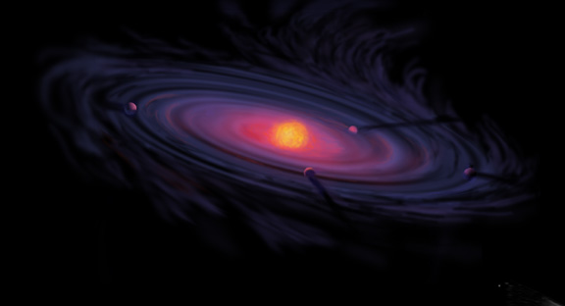
Origins of Gas Giant Compositions: The Role of Disk Location and Dynamics
Ana-Maria Piso^{1,2}
Karin Öberg², Ruth Murray-Clay³, Andrew Youdin⁴, Til Birnstiel^{2,5}
Caltech Planetary Science Seminar: February 21st, 2017
¹UCLA, Earth, Planetary, and Space Sciences Department
²Harvard-Smithsonian Center for Astrophysics
³University of California Santa Barbara
⁴Steward Observatory, University of Arizona
⁵MPIA, Heidelberg

Slide 2
Fundamental Questions
Where in the disk can giant planets form?
What compositions will the formed giant planets have obtained?

Slide 3
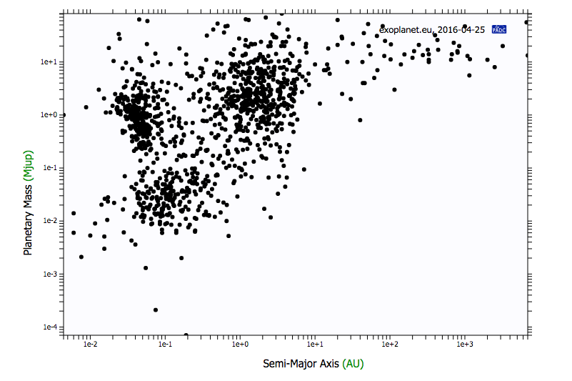
exoplanet.eu
Notes:
Circle part of diagram that I am interested in and then say directly say why; put planetary mass on y axis; also circle hot jupiters since those are the ones whose atmospheres we can characterize

Slide 4
exoplanet.eu
Notes:
Circle part of diagram that I am interested in and then say directly say why; put planetary mass on y axis; also circle hot jupiters since those are the ones whose atmospheres we can characterize

Slide 5
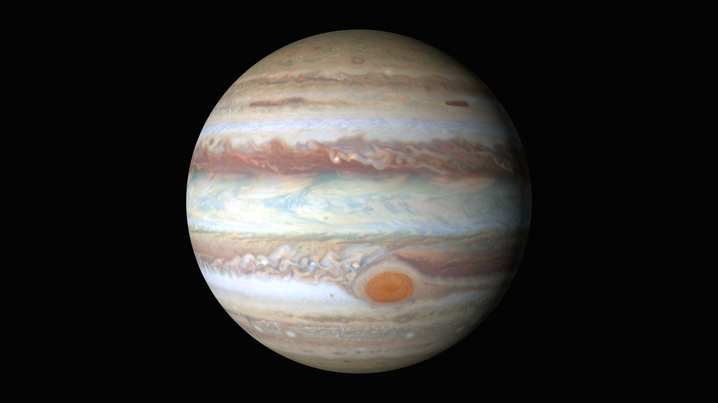
Gas Giants
Notes:
Picture of e.g. Jupiter and discuss why gas giants are important, and why we preferentially look at giant planets atmospheric spectra; there are also more problematic to form

Slide 6
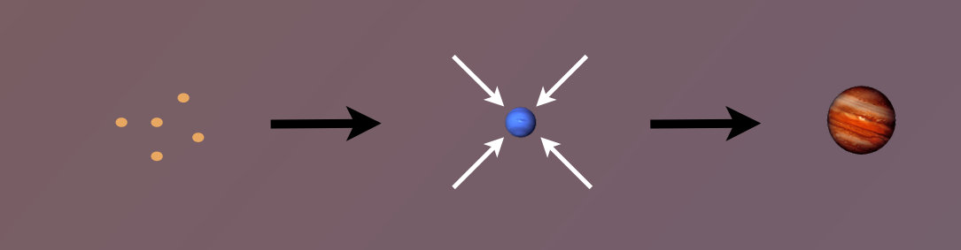
Disk-Planet Connection
The composition of planets is determined by and tightly linked to the disk composition

Slide 7
Talk Structure
The role of disk location in the formation of wide separation gas giants (Piso et al. 2014, 2015a)
The effect of disk structure and composition at different radii on the eventual composition of giant planets (Piso et al. 2015b, Piso et al. 2016)

Slide 8
Talk Structure
The role of disk location in the formation of wide separation gas giants (Piso et al. 2014, 2015a)
The effect of disk structure and composition at different radii on the eventual composition of giant planets (Piso et al. 2015b, Piso et al. 2016)

Slide 9
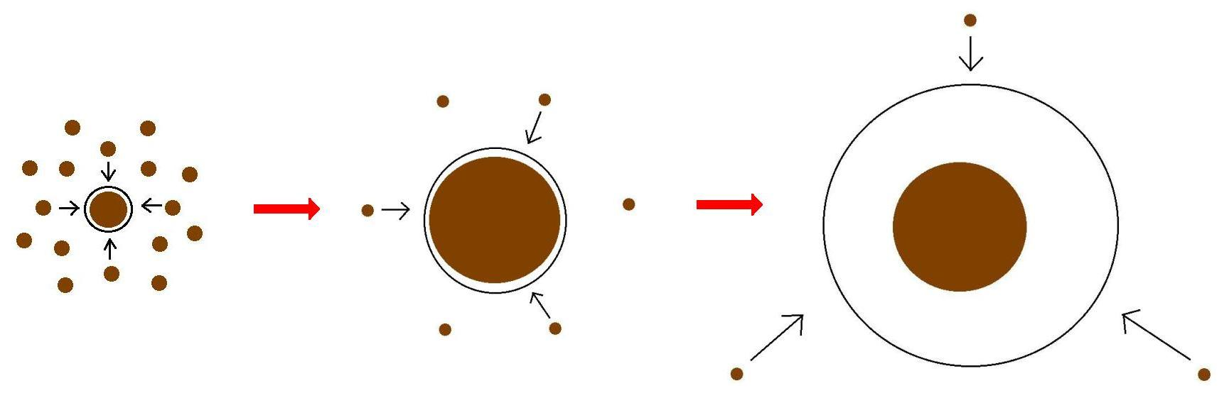
Minimum Core Masses for Giant Planet Formation

Slide 10
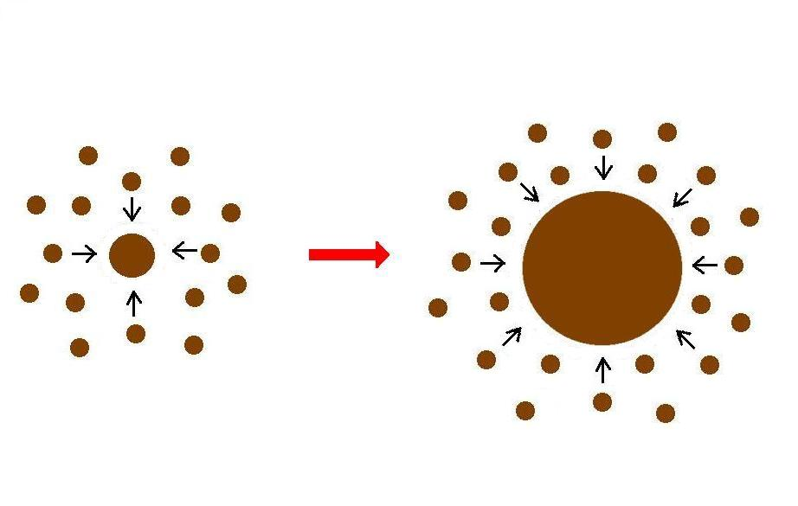
Giant planet formation requires fast core growth

Slide 11
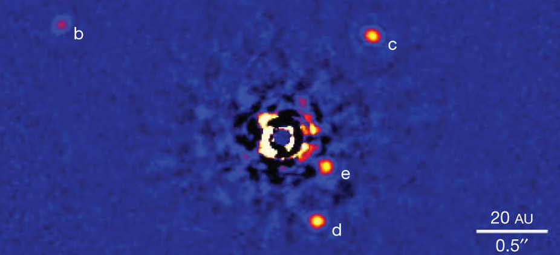
Marois+2010

Slide 12
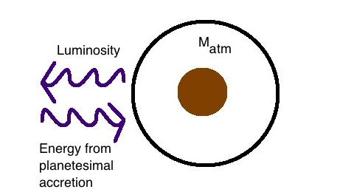
Core Accretion at high planetesimal accretion rates yields steady state
=> M_{atm} is a function of M_{core}
M_{core}

Slide 13
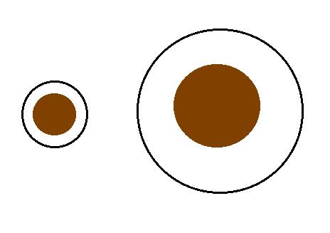
High planetesimal accretion
ONE M_{atm} for each M_{core}
=> ONE core mass for which M_{atm} ~ M_{core} = “critical core mass”
M_{atm,2}
M_{atm,1}
M_{core,1}
M_{core,2}

Slide 14
Planetesimal accretion is not constant at a given location throughout disk life
e.g., Pollack+96, Ikoma+00
M_{atm} << M_{core}
HIGH dM_{core}/dt
M_{atm} << M_{core}
dM_{core}/dt goes down
M_{atm} ≤ M_{core}
LOW dM_{core}/dt

Slide 15
Planetesimal accretion is not constant at a given location throughout disk life
e.g., Pollack+96, Ikoma+00
M_{atm} << M_{core}
HIGH dM_{core}/dt
M_{atm} << M_{core}
dM_{core}/dt goes down
M_{atm} ≤ M_{core}
LOW dM_{core}/dt

Slide 16
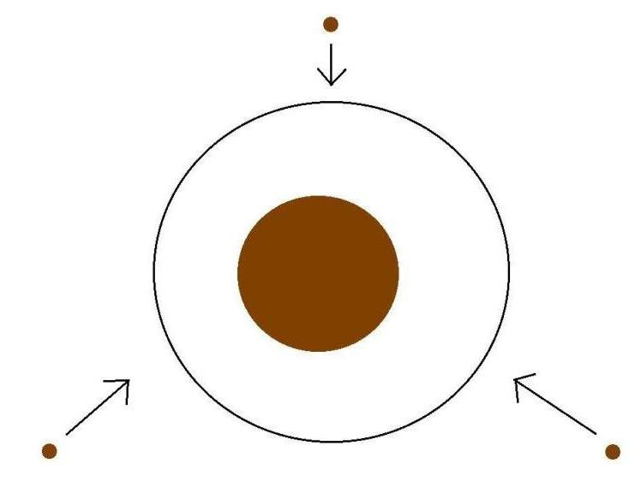
Low planetesimal accretion regime
Atmospheric evolution dominated by
Kelvin-Helmholtz contraction
M_{atm}
M_{core}
M_{atm} ≤ M_{core}
LOW dM_{core}/dt

Slide 17
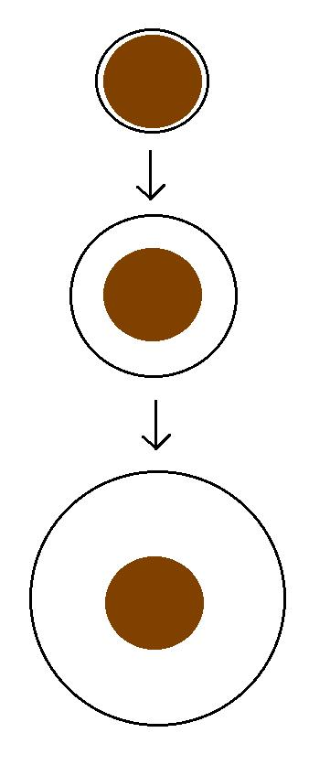
Kelvin-Helmholtz contraction
M_{atm} is a function of time
=> EVERY core can have
M_{atm} ~ M_{core}
“critical core mass”
M_{crit} = M_{core} for which
M_{atm}(t_{disk}) ~ M_{core}
M_{atm}(t₁)
M_{core}
M_{atm}(t₂)
M_{core}
M_{atm}(t₃) ~ M_{core}
M_{core}

Slide 18
GOAL
Determine the minimum core mass, M_{crit}, to form a giant planet during the disk lifetime in the low planetesimal accretion regime when atmosphere dominated by KH contraction
Calculate M_{crit} with
REALISTIC EQUATION OF STATE (EOS)
REALISTIC DUST OPACITIES

Slide 19
Model Assumptions
Negligible planetesimal accretion => solid core of fixed mass M_{c}
Atmosphere is embedded in the gas disk, spherically symmetric and in hydrostatic balance
Two layer atmosphere: inner convective region and outer radiative region
Constant luminosity throughout the radiative region
see Piso & Youdin (2014) for details

Slide 20
Static profiles connected by global cooling equation
CONVECTIVE
RADIATIVE
L ~ -dE/dt
a = 10 AU, M_{c} = 5 M_{E}
Adiabatic gradient relates P, T, rho => determines atmospheric profile and parametrizes EOS
a = 10 AU, M_{c} = 5 M_{E}

Slide 21
Atmospheric evolution and M_{crit} are highly dependent on
EQUATION OF STATE
DUST OPACITY

Slide 22
Atmospheric evolution and M_{crit} are highly dependent on
EQUATION OF STATE
DUST OPACITY

Slide 23
Adiabatic gradient is variable for realistic EOS
Piso, Youdin, & Murray-Clay (2015)

Slide 24
Adiabatic gradient is variable for realistic EOS
Saumon+95
Piso, Youdin, & Murray-Clay (2015)
Our extension

Slide 25
Adiabatic gradient is variable for realistic EOS
Piso, Youdin, & Murray-Clay (2015)
H2 dissociation
H ionization
Ideal gas

Slide 26
Adiabatic gradient is variable for realistic EOS
Piso, Youdin, & Murray-Clay (2015)
Partially excited H₂ rotational states

Slide 27
Adiabatic gradient is variable for realistic EOS
H₂ spin isomers ORTHOHYDROGEN and PARAHYDROGEN can be in thermal equilibrium or fixed ratio
Piso, Youdin, & Murray-Clay (2015)
Ortho-para equilibrium
Fixed 3:1 ortho-to-para ratio
Partially excited H₂ rotational states

Slide 28
Variations in due to non-ideal EOS effects INCREASE M_{crit}
ad
t_disk ~ 3 Myr, ISM opacity
Piso, Youdin, & Murray-Clay (2015)

Slide 29
Atmospheric evolution and M_{crit} are highly dependent on
EQUATION OF STATE
DUST OPACITY

Slide 30
Atmospheric evolution and M_{crit} are highly dependent on
EQUATION OF STATE
DUST OPACITY

Slide 31
Grain growth opacity DECREASES M_{crit}
dN/ds ~ s^{-p}
p = 3.5
s_{max} = 1 cm
t_disk ~ 3 Myr, realistic EOS
t_disk ~ 3 Myr, realistic EOS
Piso, Youdin, & Murray-Clay (2015)
Piso, Youdin, & Murray-Clay (2015)

Slide 32
Grain growth opacity DECREASES M_{crit}
dN/ds ~ s^{-p}
p = 3.5
s_{max} = 1 cm
M_{crit}:
~8 M_{E} @ 5 AU
~5 M_{E} @ 100 AU
t_disk ~ 3 Myr, realistic EOS
Piso, Youdin, & Murray-Clay (2015)

Slide 33
Grain growth opacity DECREASES M_{crit}
dN/ds ~ s^{-p}
p = 3.5
s_{max} = 1 cm
M_{crit}:
~8 M_{E} @ 5 AU
~5 M_{E} @ 100 AU
coagulation (p = 2.5)
t_disk ~ 3 Myr, realistic EOS
Piso, Youdin, & Murray-Clay (2015)

Slide 34
Takeaway point 1: M_{crit} is highly dependent on disk location and properties, and may be as low as 1 M_{E}
Marois+2010

Slide 35
Disk Compositions Regulate Planet Compositions
The composition of planets is determined by and tightly linked to the disk composition

Slide 36
Talk Structure
The role of disk location in the formation of wide separation gas giants (Piso et al. 2014, 2015a)
The effect of disk structure and composition at different radii on the eventual composition of giant planets (Piso et al. 2015b, Piso et al. 2016)

Slide 37
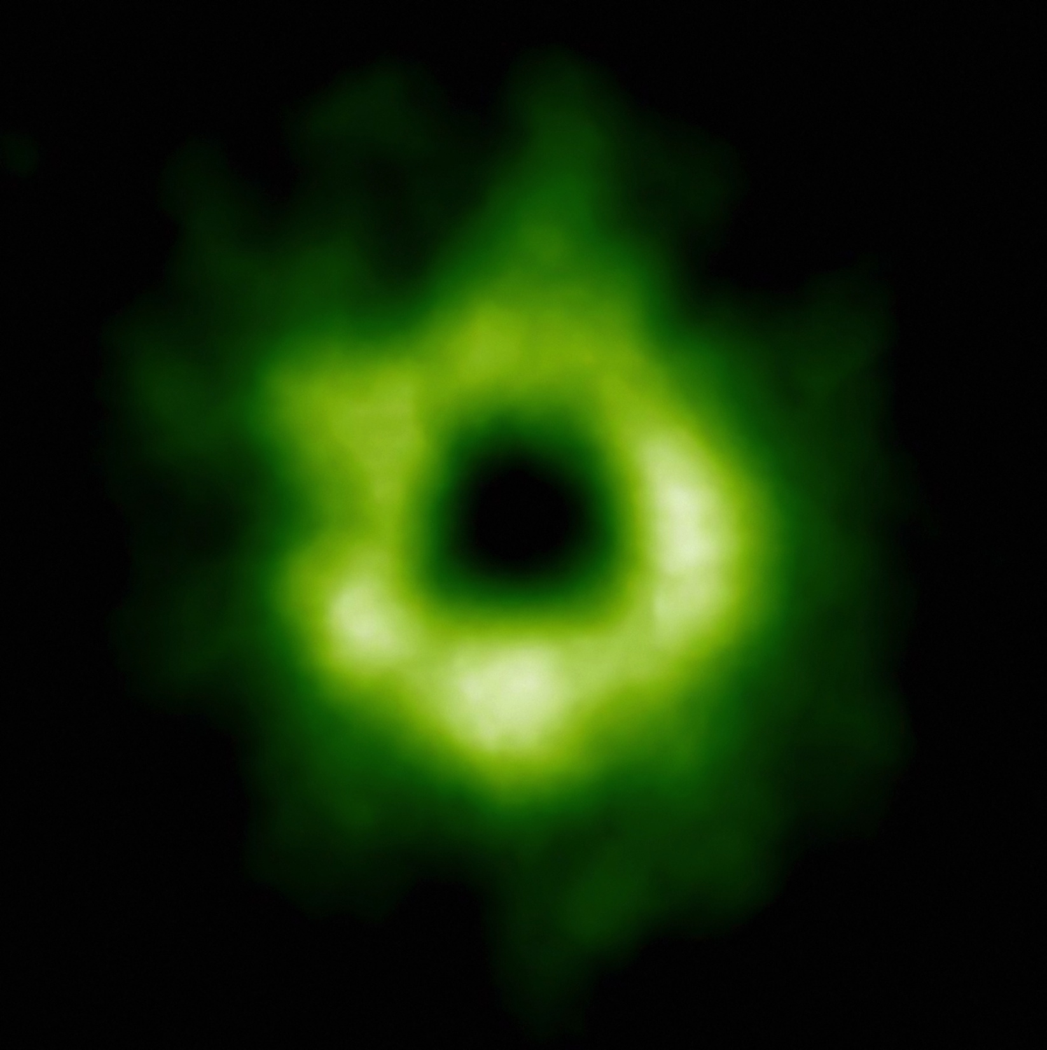
Snowline Locations in Protoplanetary Disks and C/N/O ratios
Notes:
Put the green TWHya figure instead.

Slide 38
BASIC IDEA
Understand the disk well enough to:
Predict what kind of planet compositions result from planet formation in different parts of the disk
Back-track the planet formation location based on the planet composition

Slide 39
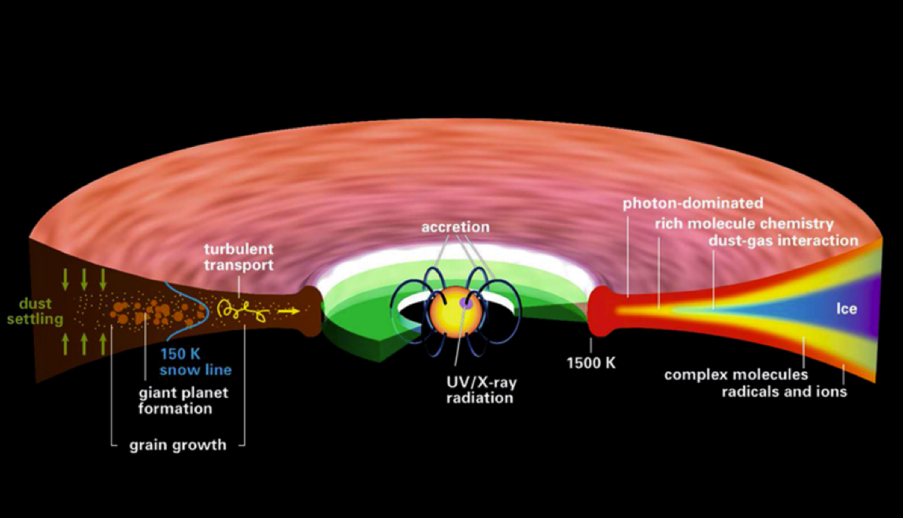
Disk structure is complex!
Henning&Semenov (2013)
Notes:
Remove the while and make the figure bigger.

Slide 40
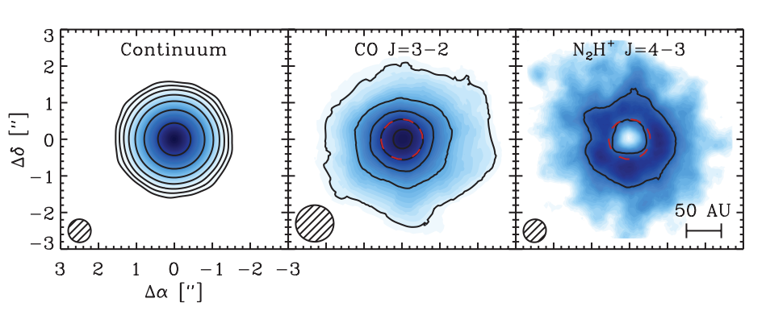
Snowlines of volatile molecules have been detected in disks
Qi+13

Slide 41
More volatile snowlines in disks
Adapted from Piso, Pegues, Oberg (2016)

Slide 42
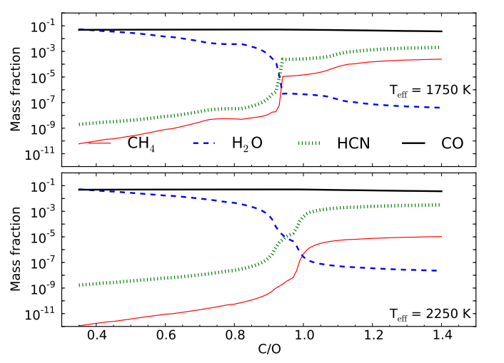
C/O ratio is an important signature of atmospheric chemistry
Molliere+15

Slide 43
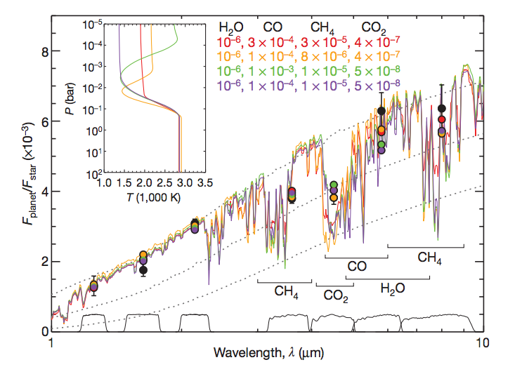
Some giant planets may have C/O ratios different from the stellar value of 0.54
Madhusudhan+11
Notes:
Show a slide before this with model predictions. Arxiv paper by katherine lodders.2009 figure 1.8

Slide 44
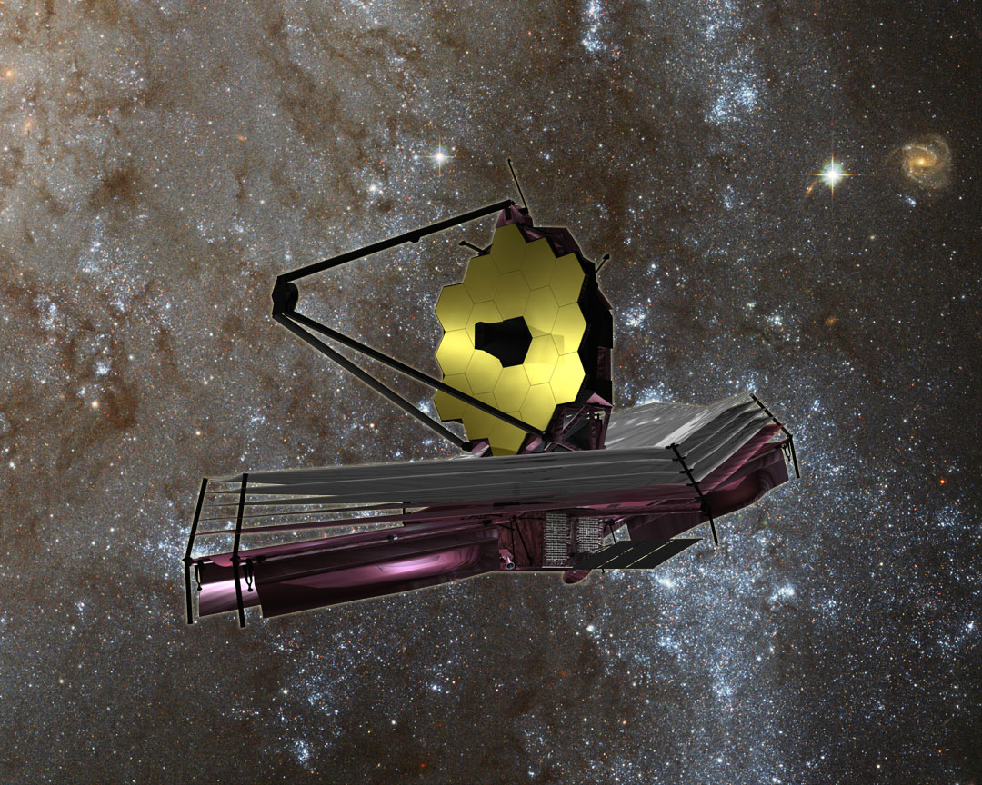
nasa.gov

Slide 45
WHY Different C/O Ratios?
Possible explanation: main carriers of C and O, i.e. H₂O, CO₂ and CO, have different condensation temperatures => variations in the abundances of C and O in solids and gas between the snow lines of these volatiles

Slide 46
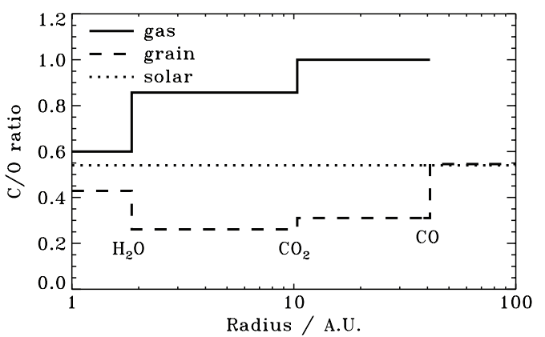
Oberg, Murray-Clay, Bergin (2011)
After Oberg+11

Slide 47
Understand how radial drift, gas accretion and ice morphology affect snowline locations, and thus the C/O ratio in gas and dust throughout the disk
GOAL

Slide 48
Radial drift of solids
Gas moves at sub-Keplerian velocity:
v_{gas} ~ v_{K} (1-c_{s}² / v_{k}²)
Small particles (~micron size) move with the gas
Large particles (~km size) are unaffected by gas drag
“Intermediate sized” particles (~cm-m size) experience a headwind and drift towards the star

Slide 49
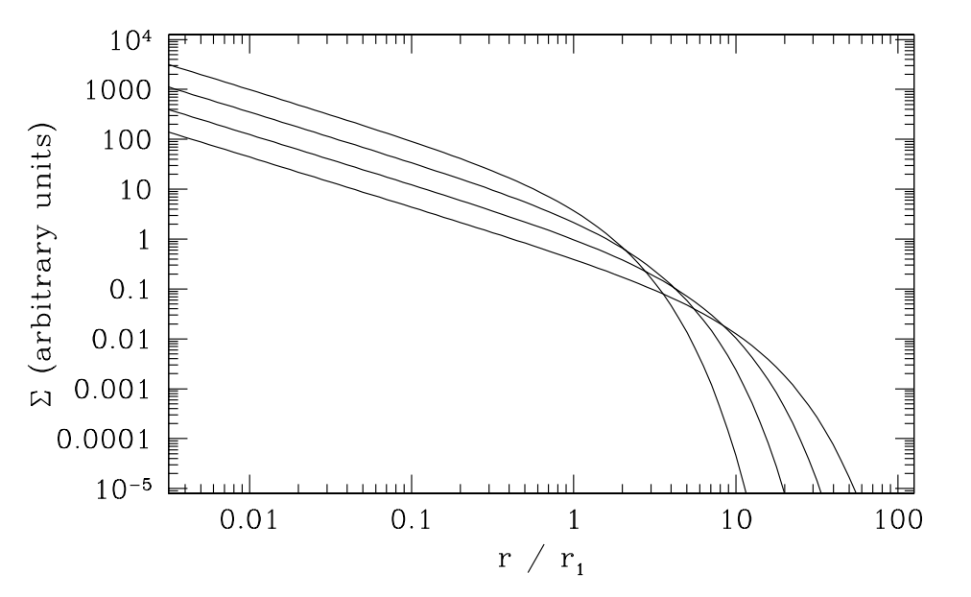
Gas disk accretes onto the central star
alpha-disk prescription: ν = α c_{s} H
Armitage 2009

Slide 50
Timescales for desorption, radial drift and gas accretion ARE comparable
Piso, Oberg, Birnstiel, Murray-Clay (2015)

Slide 51
We determined upper limits for the C/O ratio across the disk
Piso, Oberg, Birnstiel, Murray-Clay (2015)

Slide 52
Ice Morphology
The binding energies of CO varies by a factor of ~1.7 depending on whether CO is pure or water dominated ice
Adapted from Fayolle+16

Slide 53
Disk dynamics and ice morphology may change the CO snowline location by a factor of 7!
Piso, Pegues, Oberg (2016)
Notes:
Split in 2 slides; talk about N/O, then next slide say the same holds true for C/O

Slide 54
Disk dynamics and ice morphology may change the CO snowline location by a factor of 7!
H₂O
CO₂
CO
Piso, Pegues, Oberg (2016)
Notes:
Split in 2 slides; talk about N/O, then next slide say the same holds true for C/O

Slide 55
Disk dynamics and ice morphology may change the CO snowline location by a factor of 7!
H₂O
CO₂
CO
Disk dynamics
=> factor of ~2
Piso, Pegues, Oberg (2016)
Notes:
Split in 2 slides; talk about N/O, then next slide say the same holds true for C/O

Slide 56
Disk dynamics and ice morphology may change the CO snowline location by a factor of 7!
H₂O
CO₂
CO
Disk dynamics
=> factor of ~2
Ice morphology
=> factor of ~3-4
Piso, Pegues, Oberg (2016)
Notes:
Split in 2 slides; talk about N/O, then next slide say the same holds true for C/O

Slide 57
Disk dynamics and ice morphology may change the CO snowline location by a factor of 7!
H₂O
CO₂
CO
Disk dynamics
=> factor of ~2
Ice morphology
=> factor of ~3-4
CO snowlines span 9-61 AU!
Piso, Pegues, Oberg (2016)
Notes:
Split in 2 slides; talk about N/O, then next slide say the same holds true for C/O

Slide 58
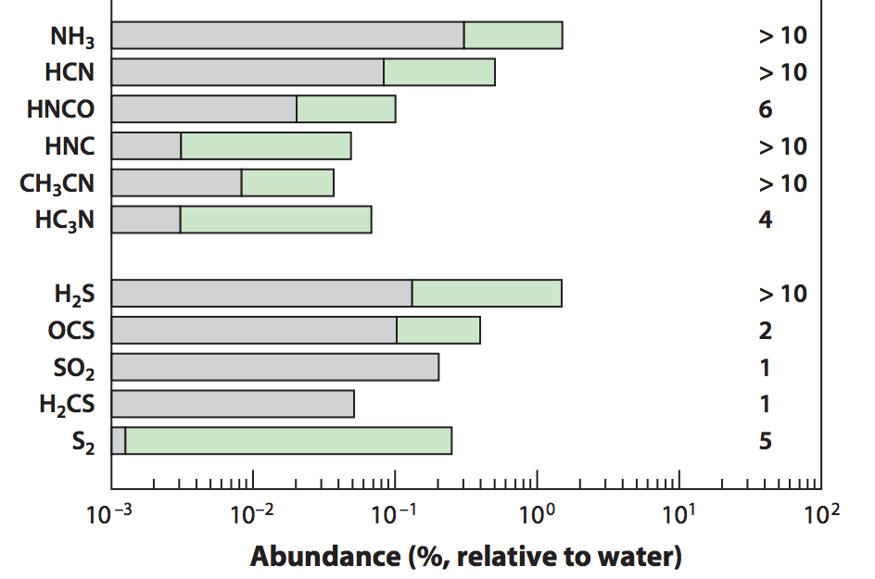
Nitrogen is important!
Add nitrogen-bearing molecules – nitrogen highly abundant in the Solar System and in disks and primarily found as N₂
Some N present in the form of NH₃
=> Use the median and maximum NH₃ abundances observed in protostellar cores from Spitzer c2d Legacy ice survey (Oberg et al. 2008, Oberg et al. 2011, etc.)
Mumma&Charnley(2011)
Notes:
Separate in two slides
Mention NH3 most abundant nitrogen carrier, bot low percentage of total N abundance => the rest in N2
Ice spectra or table
Show desorption curves from Edith’s paper

Slide 59
Ice Morphology
The binding energies of N₂ varies by a factor of ~1.7 depending on whether N2 is pure or water dominated ice
Adapted from Fayolle+16

Slide 60
N/O ratios in static disks: highly enhanced gas N/O compared to the average value
Piso, Pegues, Oberg (2016)
Notes:
1) Focus on NH3 abundance, even with max NH3 still have enhanced N/O; block out bottom 2 panels first to talk about N/O

Slide 61
Disk dynamics and ice morphology may change the N₂ snowline locations by a factor of 7!
H₂O
CO₂
CO
N₂
N₂ snowlines span 11-79 AU!
Piso, Pegues, Oberg (2016)
Notes:
Split in 2 slides; talk about N/O, then next slide say the same holds true for C/O

Slide 62
Takeaway point 2: Gas phase N/O ratios are highly enhanced throughout most of the disk compared to the average value, and more enhanced than the C/O ratio
Takeaway point 3: The locations of the CO and N₂ snowlines are highly uncertain and can span several tens of AU due to disk dynamics and ice morphology => observations are KEY

Slide 63
NEXT STEPS
Henning&Semenov (2013)

Slide 64
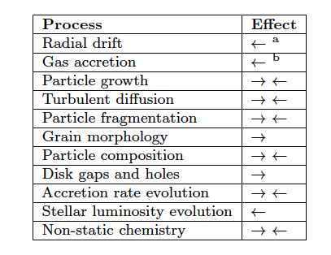
Additional chemical and dynamical processes to be explored
Piso, Oberg, Birnstiel, Murray-Clay (2015)
Piso+15
Notes:
Outline diffusion and chemistry

Slide 65
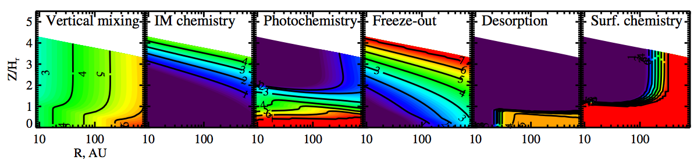
Chemistry and Dynamics need to be coupled
Semenov & Wiebe (2011)

Slide 66
Fundamental Questions
Where in the disk can giant planets form?
Piso & Youdin (2014)
Piso, Youdin, & Murray-Clay (2015)
2. What compositions will the formed giant planets have obtained?
Piso, Öberg, Birnstiel, & Murray-Clay (2015)
Piso, Pegues, & Öberg (2016)
Notes:
Write all authors

Slide 68
Coagulation p=2.5 may decrease M_{crit} by up to one order of magnitude!
M_{c} = 4 M_{E}
Realistic EOS
Piso, Youdin, & Murray-Clay (2015)

Slide 69
Radial drift affects snowline location
Irradiated disk
Evolving disk
Piso, Oberg, Birnstiel, Murray-Clay (2015)

Slide 70
The desorption distance for transition disks agrees with observations
Piso, Oberg, Birnstiel, Murray-Clay (2015)
Notes:
Cite TWHya paper

